Slide 1


The Art of Effective Communication During the Right of Way Phase

Slide 2
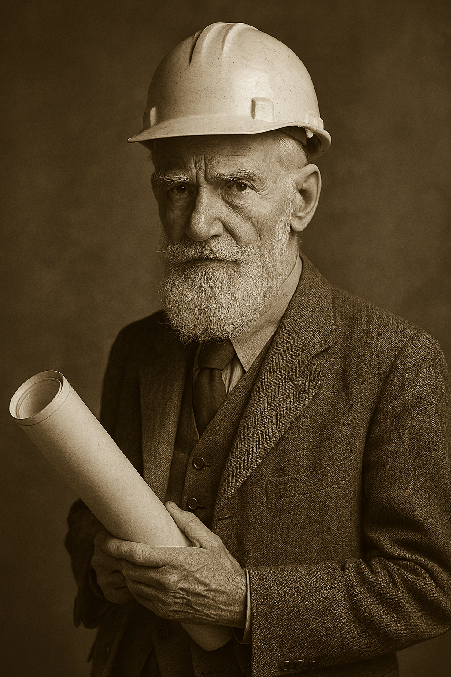


“The single biggest problem in communication is the illusion that it has taken place.”
-George Bernard Shaw

Slide 3
What is Communication why does “Arthur” have a say.
To communicate effectively, you must understand the complexity of the process—the roadmap that takes a thought, transfers it to another person, and ensures it’s received with the same clarity and intent that created it.
Communication is not just a transaction—it’s a dance, a dynamic exchange of meaning. And like any dance, it requires rhythm, awareness, and connection.
It’s not just a skill—it’s an art.
Notes:
Merriam Webster says that Communication
: a process by which information is exchanged between individuals through a common system of symbols, signs, or behavior

Slide 4
What we hope to communicate with you today
And keep you awake

Slide 5
Active Listening:
Learn how to listen with intent, not just to respond, but to understand.
Reading Between the Lines:
Decode non-verbal cues and body language to grasp the full message.
Adapting When Communication Breaks Down:
Recognize the signs of miscommunication and pivot your approach effectively.
Escalation with Purpose:
Understand when and how to escalate issues up the chain of command—and how to answer the question, “Does my boss need to know this?”
Real-World Scenarios:
Explore practical examples and case studies that bring these skills to life.

Slide 6
What is most important!

Slide 7
A little fun?
to start
Notes:
Our volunteers will try and recreate the shape. Using the most important element of communication listening
Round 1: Two of my engineer colleagues will demonstrate with a simple square shape to show how technical minds communicate with precision.
Round 2: A second pair—an engineer and a right-of-way professional—will tackle a more complex image: the ceiling of the Sistine Chapel. This will add some humor and levity while highlighting how communication can break down across disciplines, even within the same organization.

Slide 9
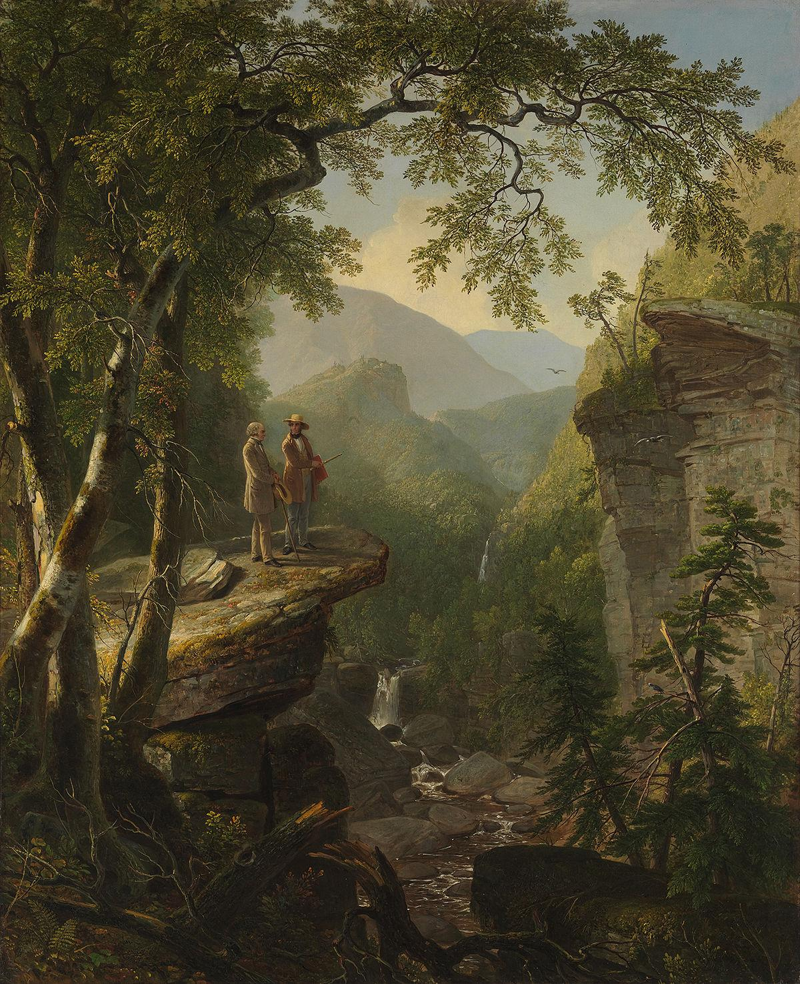
Kindred Spirits, Asher B. Durand, 1849.
Collection of Crystal Bridges Museum of American Art
Notes:
Our volunteers will try and recreate the shape. Using the most important element of communication listening

Slide 10
Active Listening
Key Elements:
Give full attention (eye contact, no distractions)
Show you’re listening (nodding, verbal affirmations like “I see” or “Go on”)
Reflect and clarify (paraphrase what you heard, ask clarifying questions)
Avoid interrupting (let the speaker finish before responding)
Respond thoughtfully
Notes:
One must be careful not to simply stare blankly at a property owner or team member. Instead, we must intently listen to what they’re saying. In our line of work, it’s often helpful to jot down small notes—breadcrumbs—to help reconstruct the conversation later, especially when writing your Record of Contact (ROC).
Pay special attention to how you respond. Don’t listen just to reply—listen to understand. Let the speaker finish without interruption, and when needed, ask occasional clarifying questions to ensure you’ve captured the full meaning.

Slide 11
Reading Between the Lines
“Wait they are saying things when they aren’t talking?”

Slide 12

Our face and bodies talk?……………But what are we saying?
Notes:
A 1967 study attempted to calculate the amount of communication is considered non verbal.
A co Author stated -When there are inconsistencies between attitudes communicated verbally and posturally, the postural component should dominate in determining the total attitude that is inferred.
When you deliver the message you must have the appropriate poster. Remember you in most cases represent “THE GOVERNMENT” saying you are there to help doesn’t if you haven’t smile shaken hands or drunk the coffee.

Slide 13
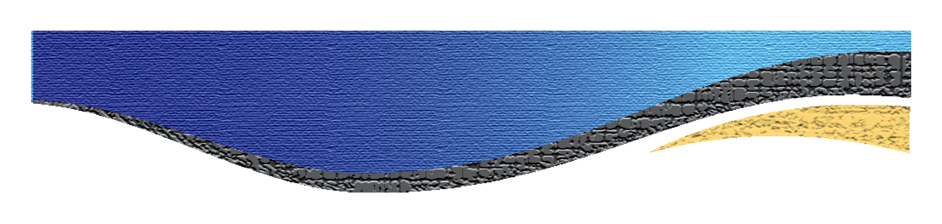
Types of Non-Verbal Expression
Facial Expressions
Gestures
Posture and Body Orientation
Eye Contact
Tone of Voice (Paralanguage)
Proxemics (Use of Space)
Appearance
Touch (Haptics)
Silence

Slide 14
Adapting When Communication Breaks Down
“Well…. I’ve scratched my nose and crossed my arms, now this guy wants me off his property”

Slide 15
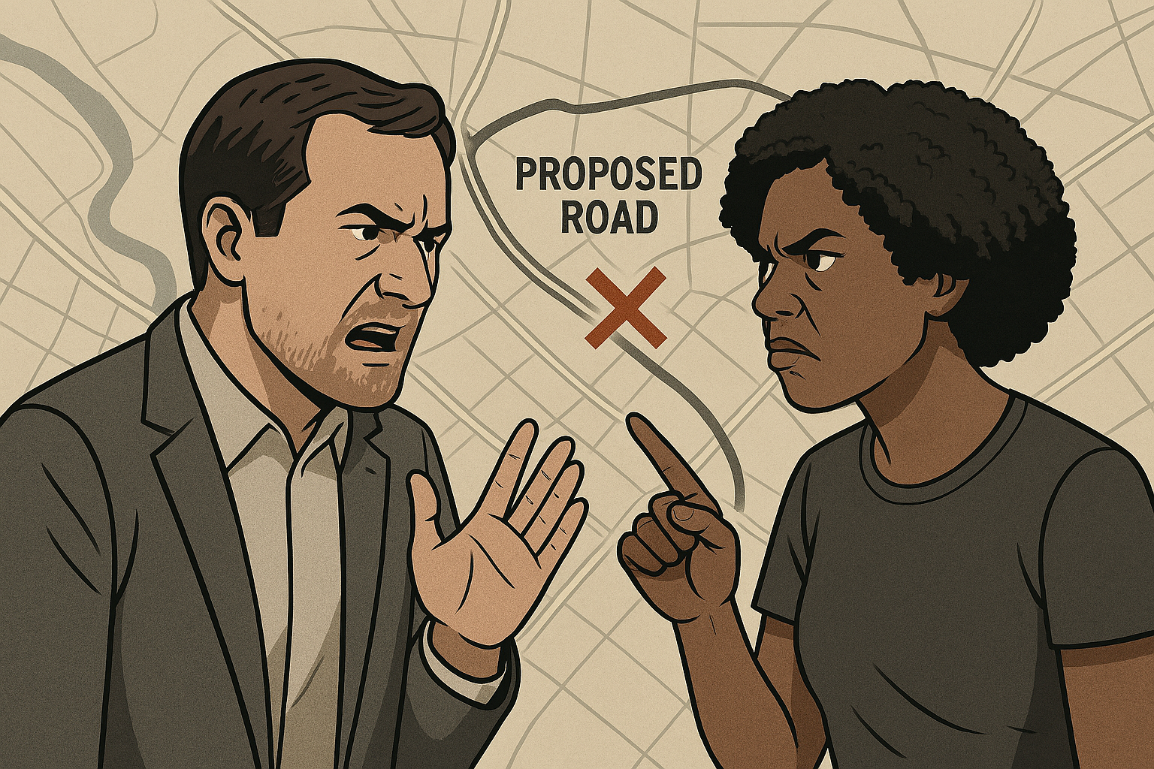
I’m here from the Government to help you!
Getting along just fine before you showed up!

Slide 16
Has Communication Broken Down
Repeated Misunderstandings
Lack of Engagement
Defensive or Aggressive Responses
Avoidance or Withdrawal
Overuse of Jargon or Vague Language
Interruptions and Talking Over Each Other
Non-Verbal Cues of Discomfort
Failure to Follow Through
Escalation Without Resolution

Slide 17
Escalation with Purpose
“If I am going up the chain I better know why ”

Slide 18

Do tell………

Slide 19
Escalate
Ensure Timely Resolution
Prevent Miscommunication or Conflict
To Protect Relationships
To Maintain Project Momentum
To Document and Support Accountability

